Slide 1
IBM University Engagement Project Submission
“Exploring the Power of Agentic AI with IBM Granite and IBM Bob”

Slide 2
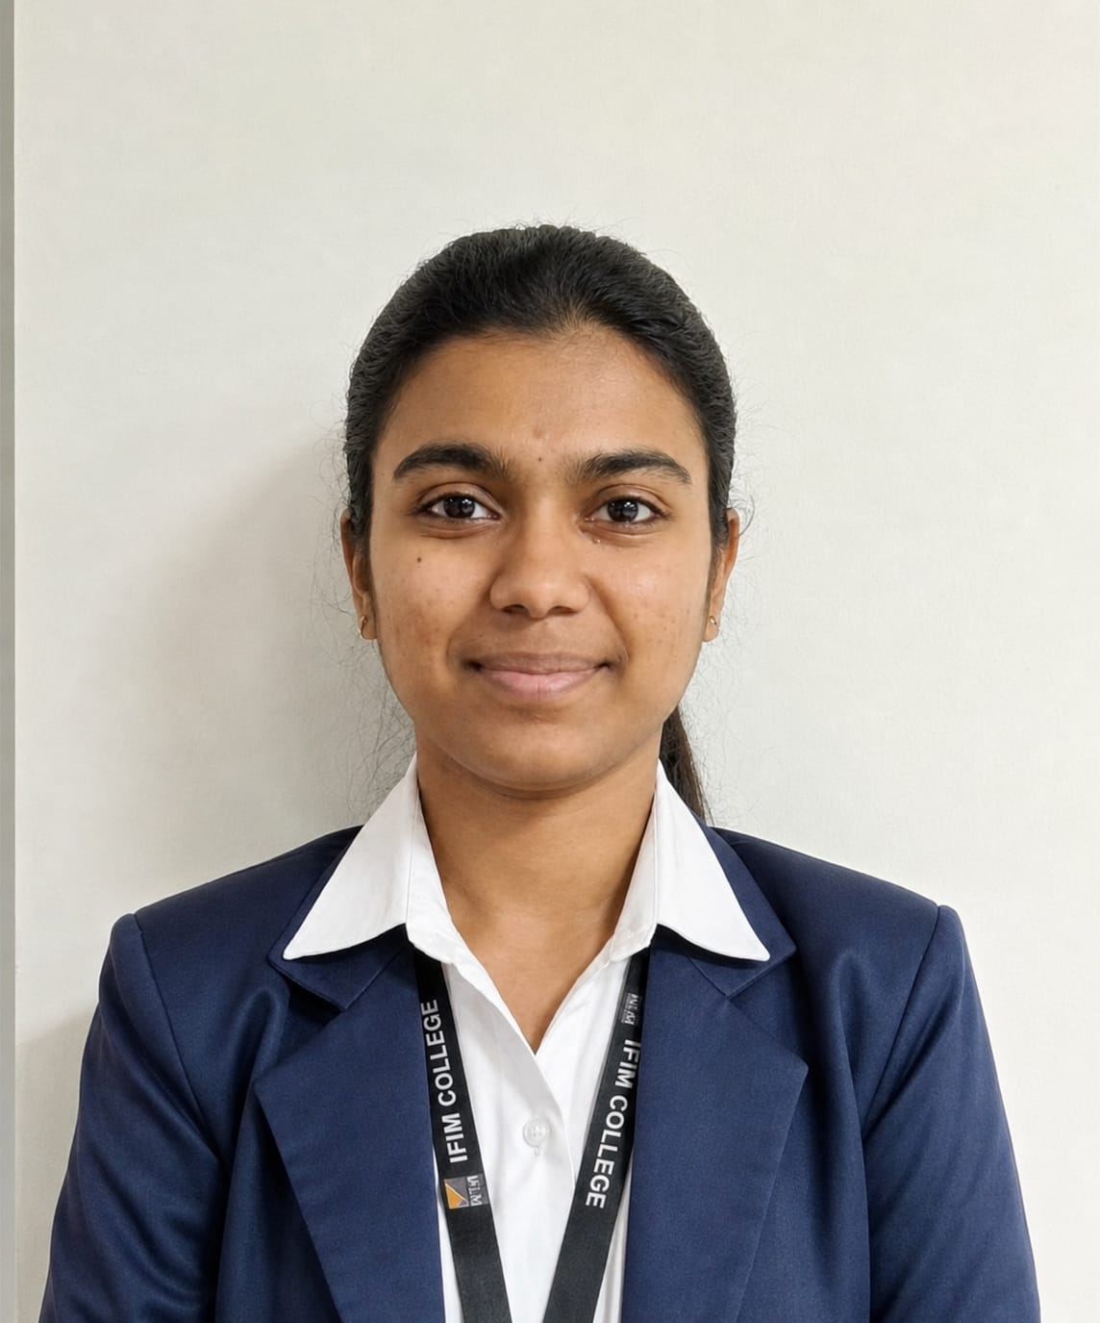
Project Tile – [StudyGen AI – Smart Study Generator Agent]
Domain of Project – [Education]
Student Name | Recent Passport Photo | Email ID | Mobile number [WhatsApp]
SNEHA S |  | snehasubramanian7070@gmail.com | 7019637672

Slide 3
Problem Statement -
Problem Statement: Smart Study Generator Agent
The Challenge
Students often have learning resources scattered across lecture notes, textbooks, research papers, YouTube tutorials, and online resources.
They may struggle to:
Find the right study material.
Understand difficult concepts.
Summarize large amounts of content.
Identify important examination topics.
Create an effective study schedule.
Track their preparation and weak areas.
Traditional study tools are often static and do not adapt to individual learning needs.
The Objective
Build an AI-powered Smart Study Generator Agent that can:
Combine different learning resources into structured study material.
Support text, PDF, image, and voice inputs.
Generate summaries, key points, flashcards, and explanations.
Create personalized study plans.
Generate and evaluate practice quizzes.
Identify weak topics and provide revision guidance.
Visualize study progress and milestones.

Slide 4
Proposed Solution -
Proposed Solution – StudyGen AI
StudyGen AI is a web-based intelligent study platform designed to help students understand, organize, practice, and plan their studies using Agentic AI.
The system consists of two specialized AI agents:
1. Study Material Agent
Processes text and uploaded study resources.
Supports PDF and image-based study material.
Supports voice-based input.
Generates summaries and key points.
Creates flashcards and concept outlines.
Provides simple explanations.
Answers questions based on provided material.
2. Study Planner & Evaluation Agent
Creates personalized day-by-day study plans.
Uses syllabus, exam date, study hours, and preparation level.
Generates MCQs.
Evaluates quiz responses.
Calculates scores and percentages.
Identifies weak topics.
Provides revision suggestions and focus areas.

Slide 5
Technology Used
Python
For application logic, AI integration, data processing, and backend development.
Flask
For developing the web application backend and API routes.
HTML, CSS & Bootstrap 5
For creating a responsive and user-friendly interface.
JavaScript
For interactive frontend functionality and communication with backend APIs.
Groq API
For fast AI inference using open-weight language models.
OpenAI GPT-OSS 20B
Used for study assistance, planning, quiz generation, evaluation, and personalized guidance.
Qwen Vision Model
Used for processing textbook pages and image-based study material.
Whisper
Used for speech-to-text functionality.
SQLite
Used for storing quiz scores, progress, weak topics, study tasks, and milestones.

Slide 6
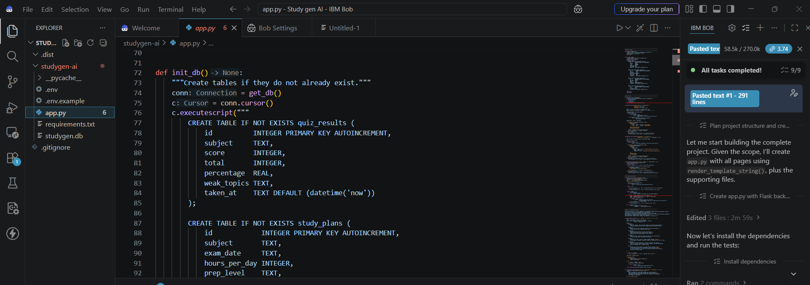
Required Files created using IBM bob -

Slide 7
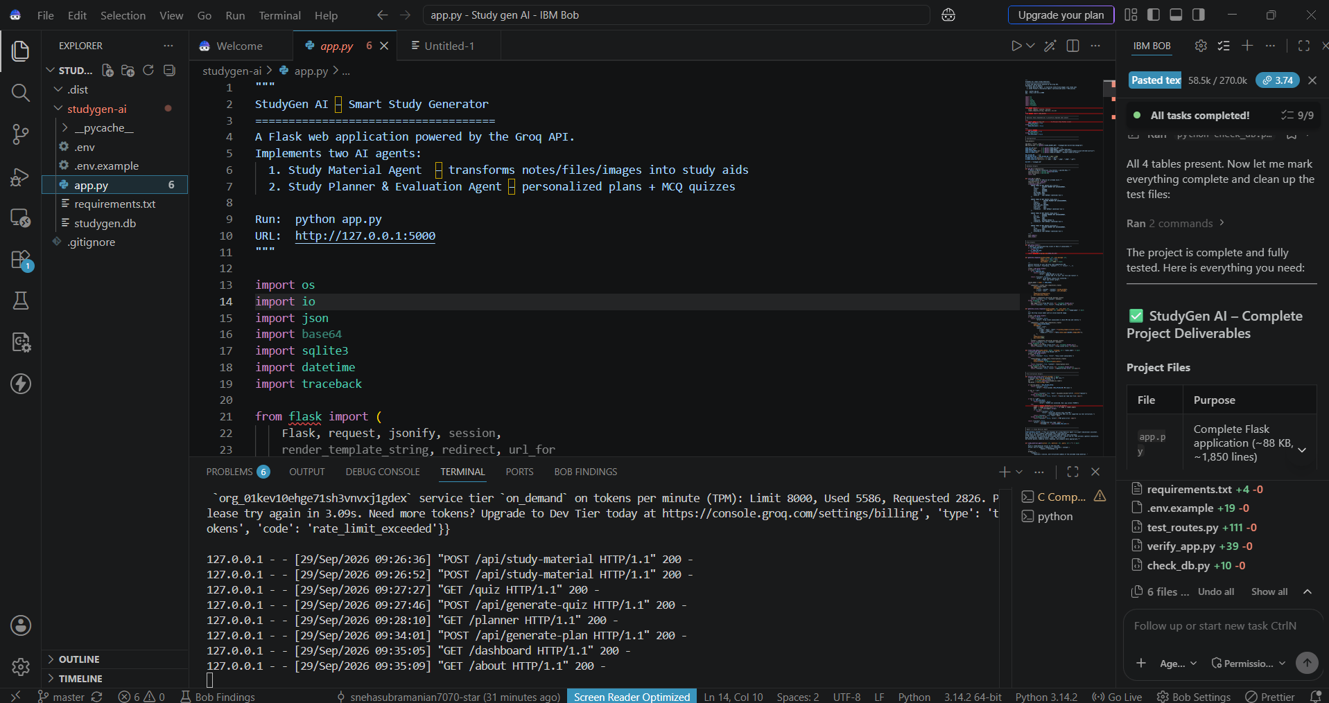
IBM Bob Screenshots:

Slide 8
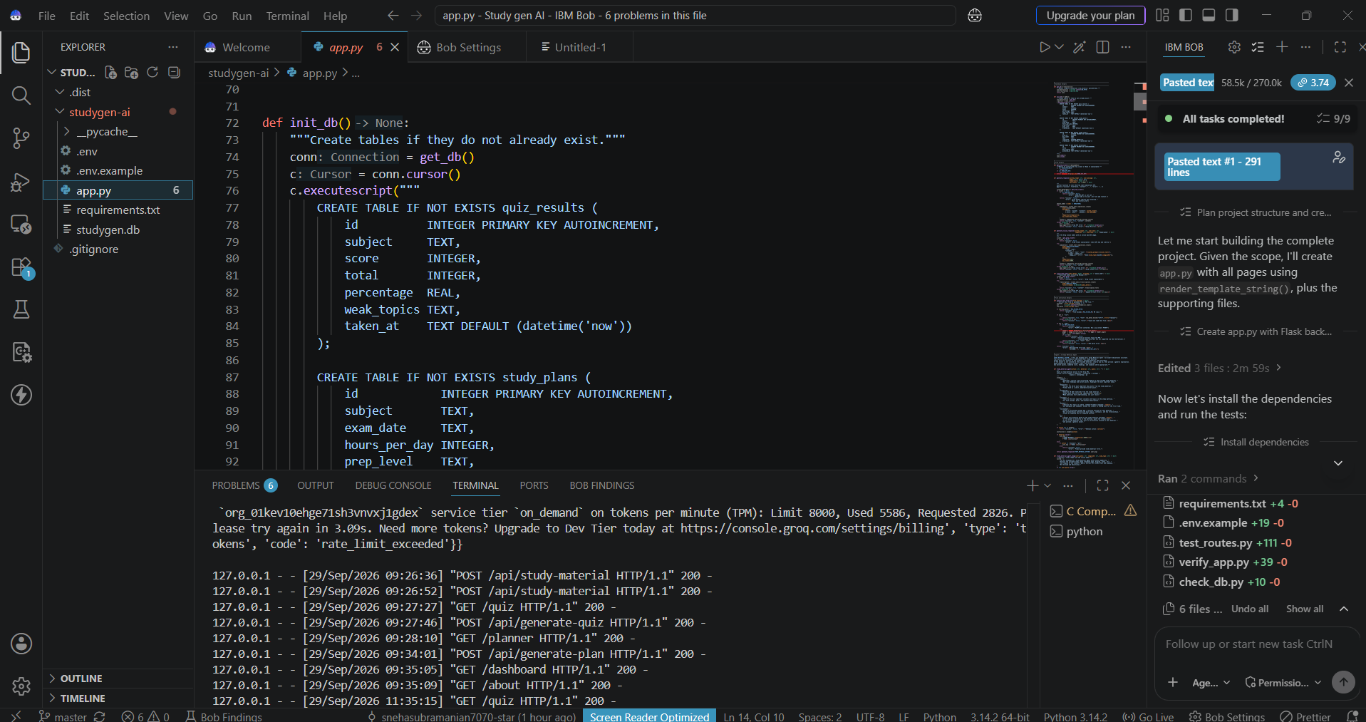

Slide 9
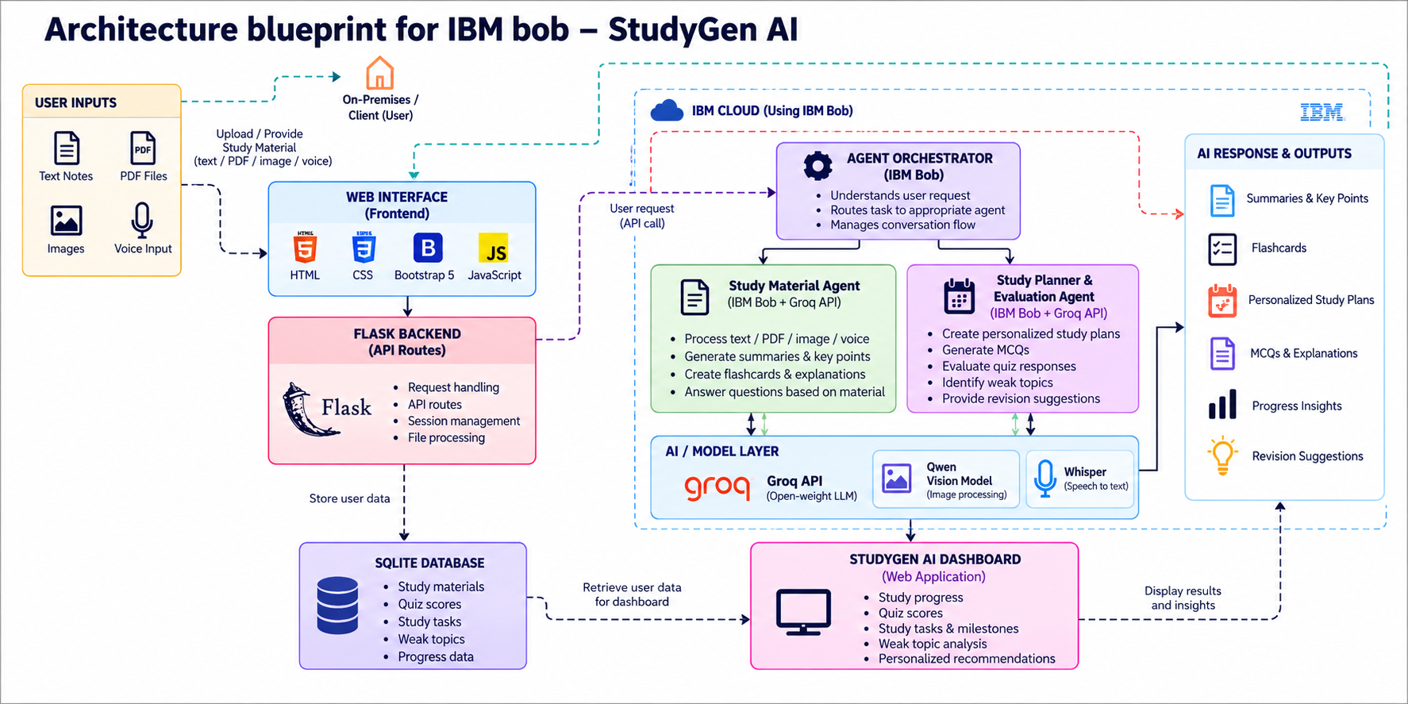
Architecture blueprint for IBM bob:

Slide 10

Role of Agentic AI in the solution
Agentic AI enables StudyGen AI to function as an intelligent and goal-oriented study assistant rather than a simple chatbot.
1. Task-Based Agents
Two specialized agents handle different student requirements:
Study Material Agent – processes learning resources and generates study aids.
Study Planner & Evaluation Agent – creates study plans, quizzes, evaluations, and revision guidance.
2. Intelligent Task Routing
The agent orchestrator identifies the student's request and routes it to the appropriate specialized agent.
3. Context-Aware Assistance
The system considers syllabus, exam date, preparation level, study hours, learning material, and quiz performance.
4. Adaptive Guidance
Quiz results and weak topics are used to provide personalized revision suggestions and focus areas.
5. Multimodal Interaction
Students can interact using text, PDFs, images, and voice.

Slide 11
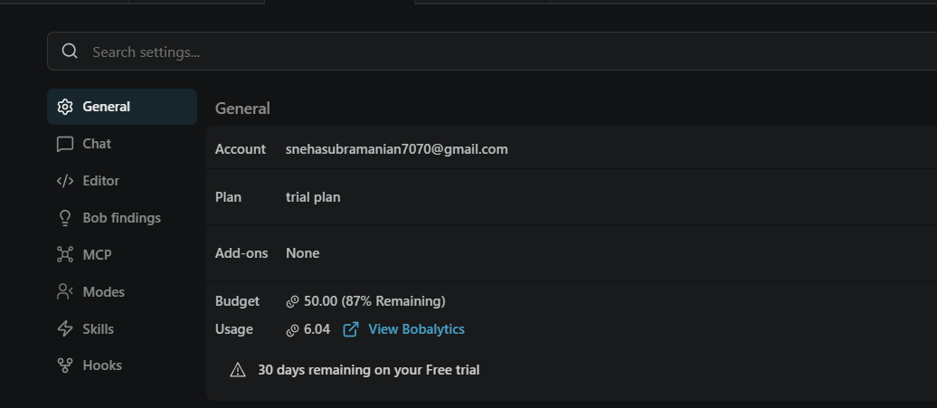
Token Usage
Token Usage: 58.5K / 270K
·
·
·

Slide 12
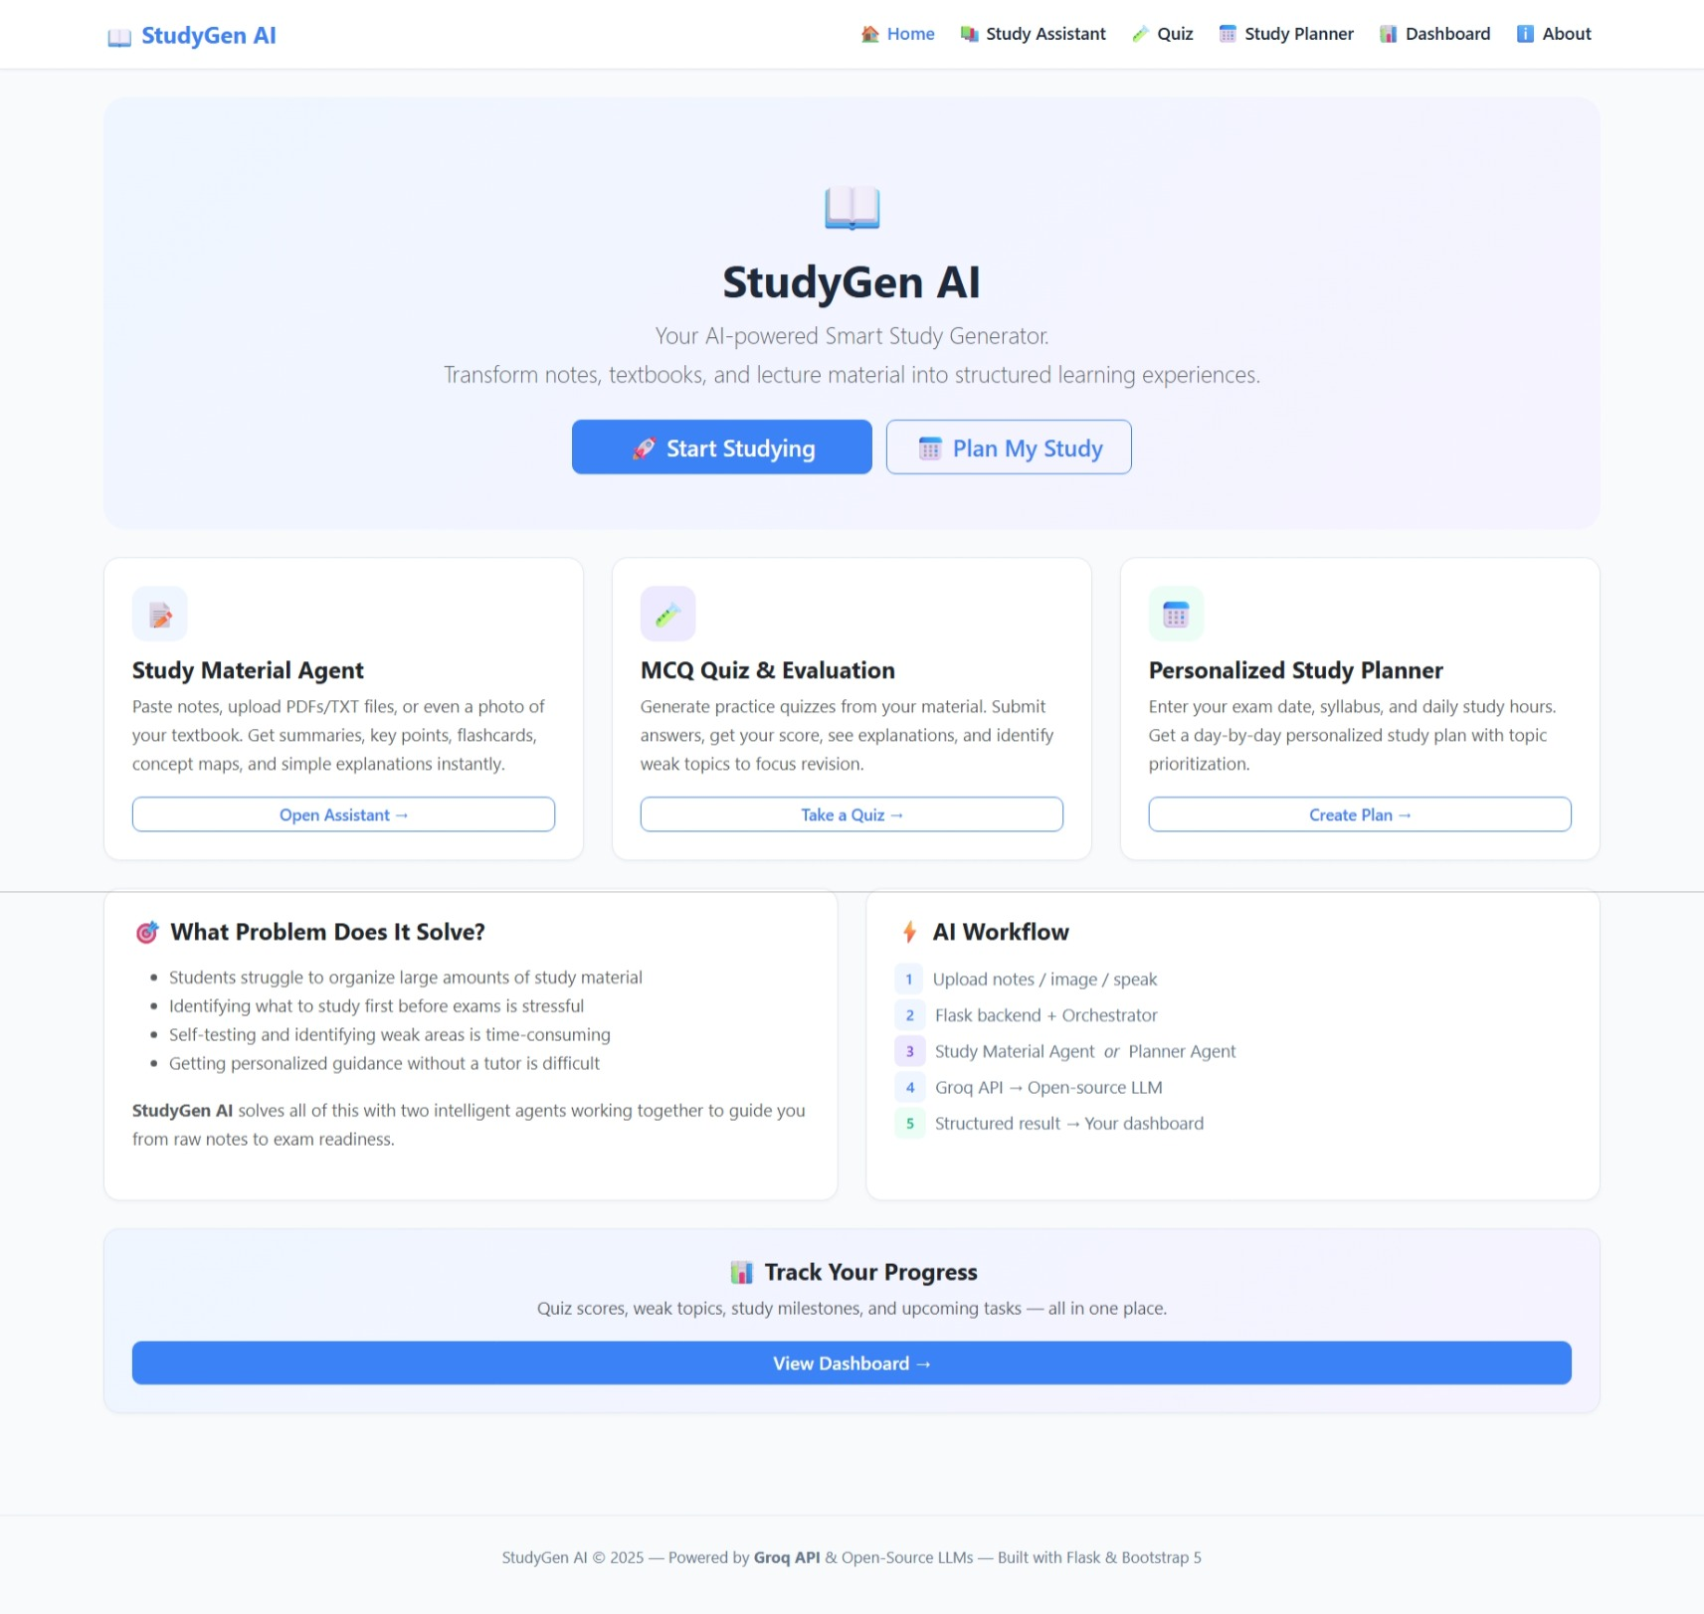
Project Output Screenshot
·
·
·

Slide 13
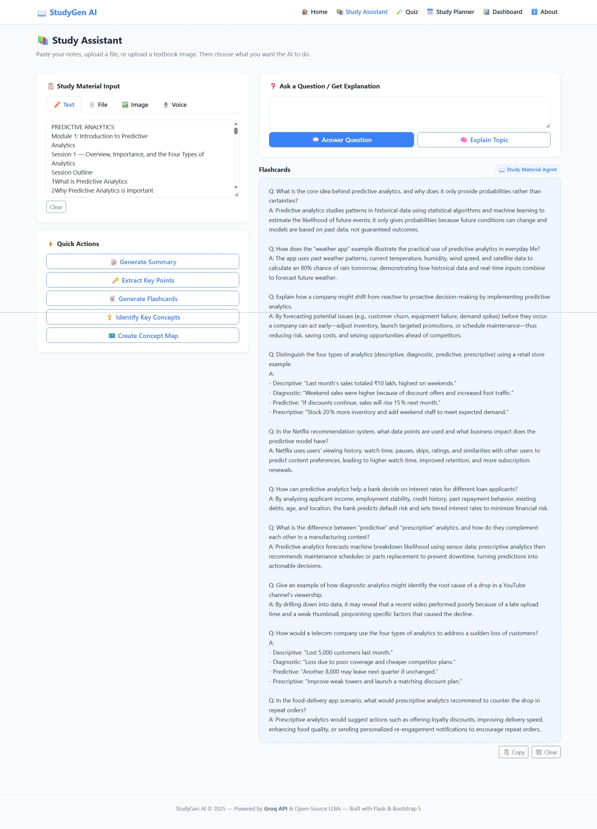
Project Output Screenshot
·
·
·

Slide 14
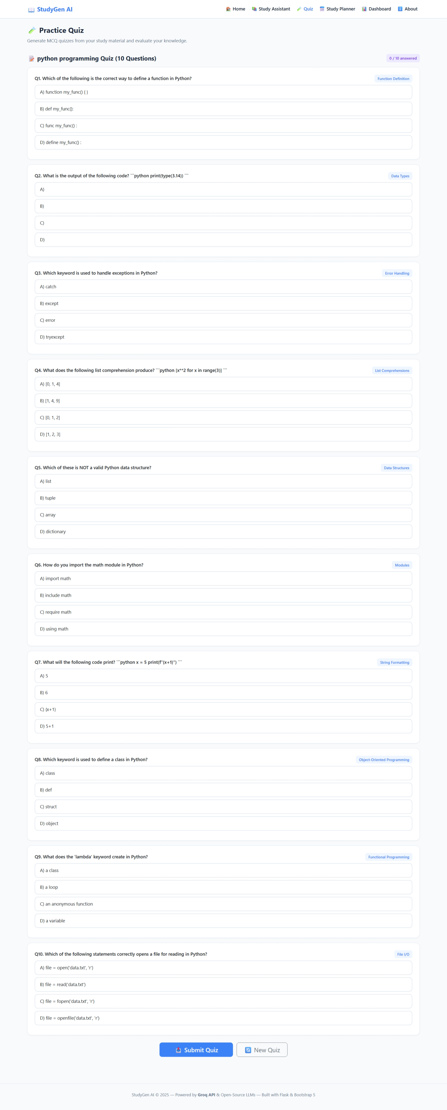
Project Output Screenshot
·
·
·

Slide 15
Novelty and Uniqueness
StudyGen AI combines Agentic AI, multimodal learning, personalized study planning, and performance evaluation into a single intelligent study platform.
Key Features
1. Multi-Agent Intelligence
Two specialized agents collaborate to handle study material assistance and study planning & evaluation.
2. Multimodal Learning
Supports text, PDF, image, and voice-based study inputs.
3. Personalized Study Planning
Creates day-by-day study schedules based on syllabus, exam date, preparation level, and available study hours.
4. Adaptive Quiz Evaluation
Generates MCQs, evaluates answers, explains mistakes, and identifies weak topics.
5. Material-Grounded Assistance
Uses the student's provided study material to generate relevant summaries, explanations, and answers.
6. Progress Tracking
Tracks quiz scores, weak topics, study tasks, and milestones through the dashboard.
7. Personalized Guidance
Provides revision suggestions and focus areas based on the student's performance.

Slide 16
Git Hub Link
Github URL –
snehasubramanian7070-star/Study-gen-AI: AI-powered Smart Study Generator using Flask, Groq API and open-source LLMs.
·
·
·

Slide 17
Future Scope
1. Advanced Learning Analytics
Analyze topic mastery, learning patterns, quiz performance, and long-term study progress.
2. Multilingual Learning Support
Support multiple languages to make the platform accessible to a wider range of students.
3. Advanced Voice Interaction
Enable more natural voice-based conversations for hands-free learning.
4. Expanded Learning Resources
Integrate additional educational resources, institutional materials, and online learning content.
5. Collaborative Learning
Allow students to share study materials, quizzes, flashcards, and study plans with classmates.
6. Adaptive Learning
Automatically adjust study plans based on quiz performance, weak topics, and learning progress.
7. Cloud Deployment
Deploy StudyGen AI on a cloud platform for wider accessibility and scalability
·
·
·

Slide 18
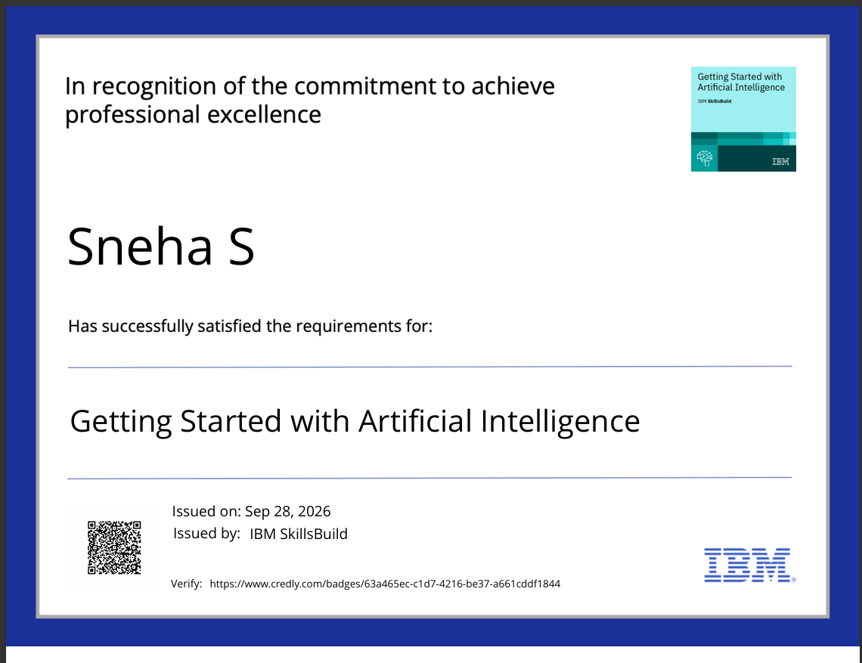
Certificates Earned:

Slide 19
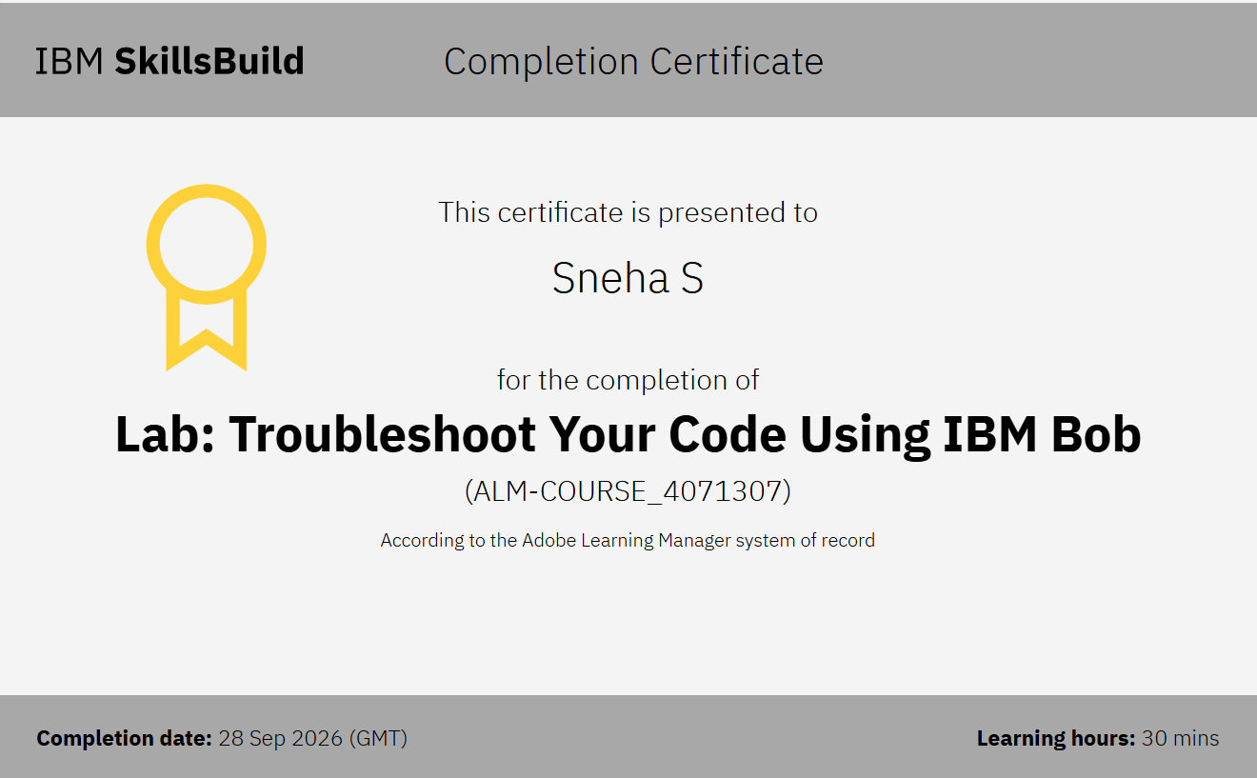
Certificates Earned:​

Slide 20
THANK YOU

